Slide 1
MODULE-2
BCSE306
Artificial Intelligence
Dr.Priyanka.N
Assistant Professor
School of Computer Science and Engineering (SCOPE),
VIT Vellore,
Priyanka.n@vit.ac.in

Slide 2
Depth-first search
Depth-first search (DFS) is an algorithm for traversing or searching tree or graph data structures.
The algorithm starts at the root node (selecting some arbitrary node as the root node in the case of a graph) and explores as far as possible along each branch before backtracking.
It uses the Last In-First-Out (LIFO) strategy and hence it is implemented using a stack.
As DFS traverses the tree “deepest node first”, it would always picks the deeper branch until it reaches the solution (or it runs out of nodes, and goes to the next branch).

Slide 3
Algorithm
Create a recursive function that takes the index of the node and a visited array.
Mark the current node as visited and print the node.
Traverse all the adjacent and unmarked nodes and call the recursive function with the index of the adjacent node.

Slide 4
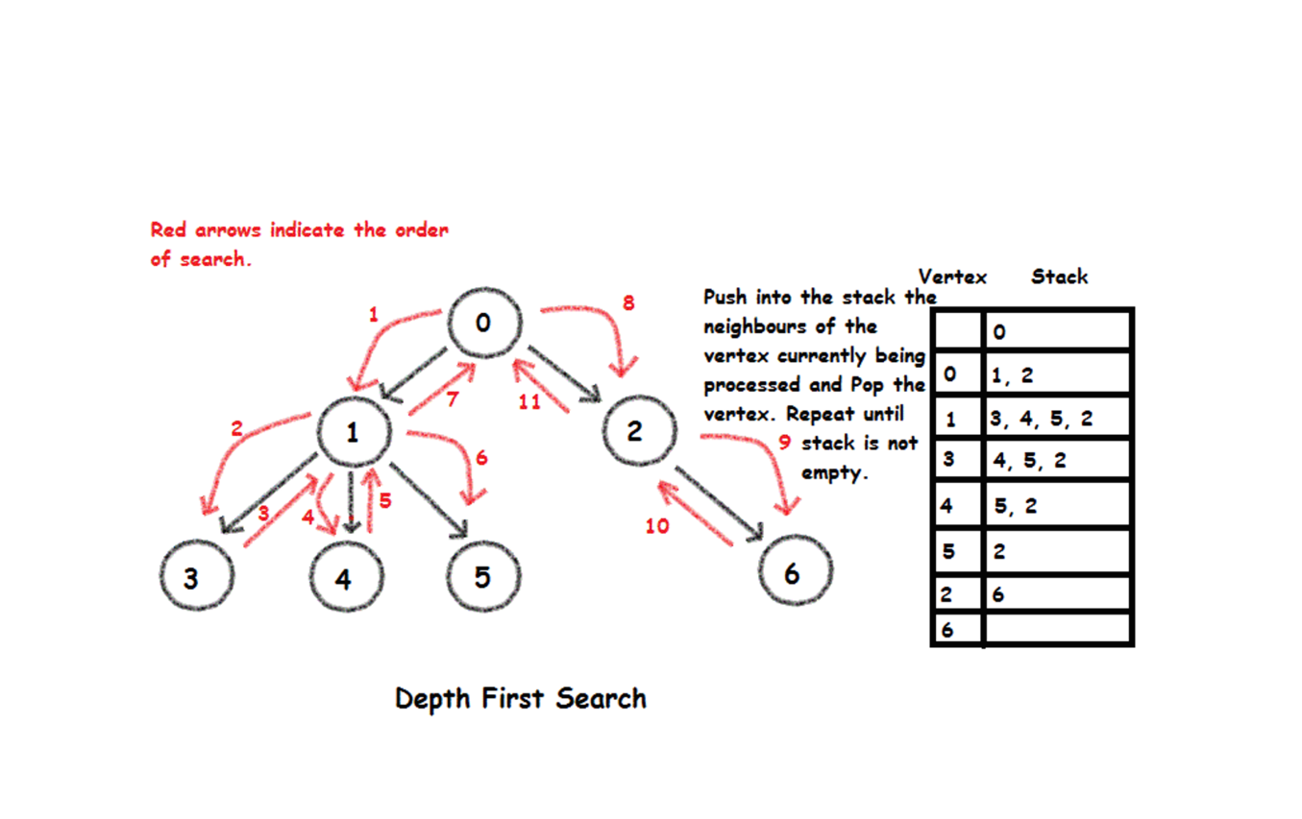
Example of DFS

Slide 5
Advantages
It requires very little memory as it only needs to store a stack of the nodes on the path from the root node to the current node.
It takes less time to reach the goal node than the BFS algorithm.
Disadvantage
There is the possibility that many states keep re-occurring and there is no guarantee of finding the solution.
DFS Algorithm goes for deep down searching and sometimes it may go to the infinite loop.

Slide 6
Time complexity: Equivalent to the number of nodes traversed in DFS.
T(n) = 1 + n^2 + n^3 + ... + n^d = O(n^d)
D = the depth of the search tree = the number of levels of the search tree.
n^I = number of nodes in level I
Space complexity: Equivalent to how large can the fringe get.
S(n) = O(n*d)

Slide 7
Completeness: DFS is complete if the search tree is finite, meaning for a given finite search tree, DFS will come up with a solution if it exists.
Optimality: DFS is not optimal, meaning the number of steps in reaching the solution, or the cost spent in reaching it, is high.

Slide 8
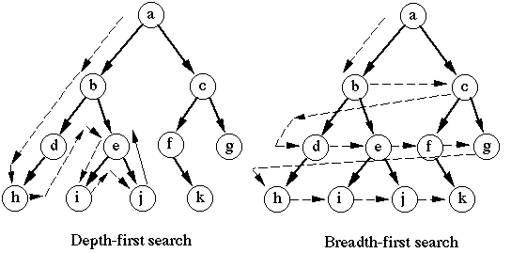

Slide 9
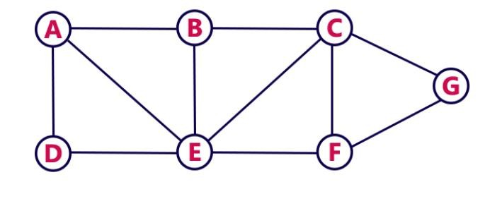
Depth First Search
DFS traversal of a graph produces a spanning tree as a result
Spanning Tree is a graph without loops
Consider the Following Example

Slide 10




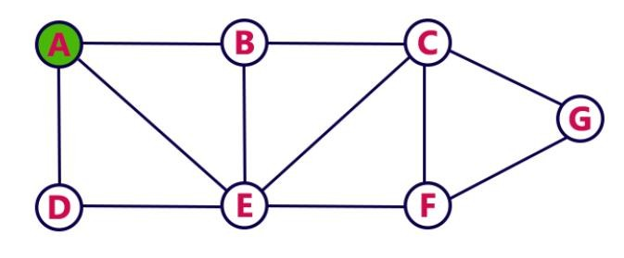
Depth First Search- STEP1
Choose the Starting Vertex as A
VISIT A
Push A into the Stack
A
RESULT: A
STACK

Slide 11
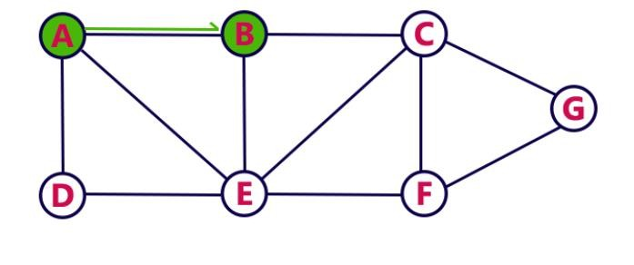
Depth First Search- STEP 2
Visit any adjacent vertex of A which is not visited ( taken B)
VISIT B
Push newly visited B into the Stack
B
A
RESULT: A B
STACK

Slide 12
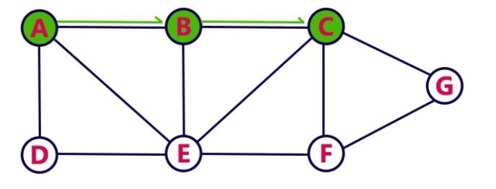
Depth First Search- STEP 3
Visit any adjacent vertex of B which is not visited ( taken C)
VISIT C
Push newly visited C into the Stack
C
B
A
RESULT: A B C
STACK

Slide 13
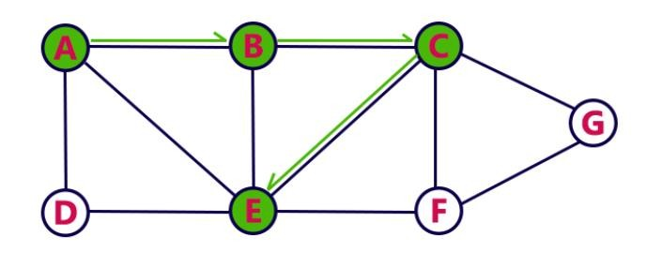
Depth First Search- STEP 4
Visit any adjacent vertex of C which is not visited ( taken E)
VISIT E
Push newly visited E into the Stack
E
C
B
A
RESULT: A B C E
STACK

Slide 14
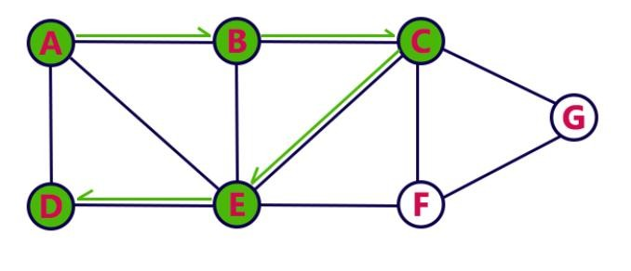
Depth First Search- STEP 5
Visit any adjacent vertex of E which is not visited ( taken D)
VISIT D
Push newly visited D into the Stack
D
E
C
B
A
RESULT: A B C E D
STACK

Slide 15
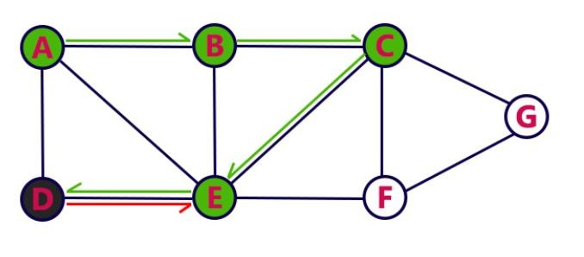
Depth First Search- STEP 6
No new vertex to be visited from D
POP D
E
C
B
A
RESULT: A B C E D
STACK

Slide 16

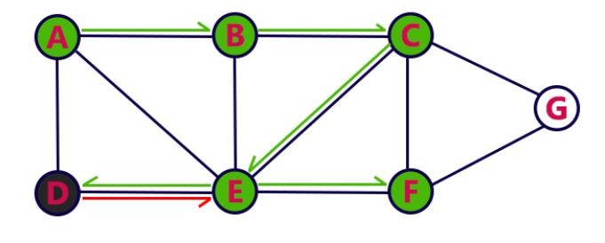
Depth First Search- STEP 7
Visit any adjacent vertex of E which is not visited ( taken F)
VISIT F
Push newly visited F into the Stack
F
E
C
B
A
RESULT: A B C E D F
STACK

Slide 17
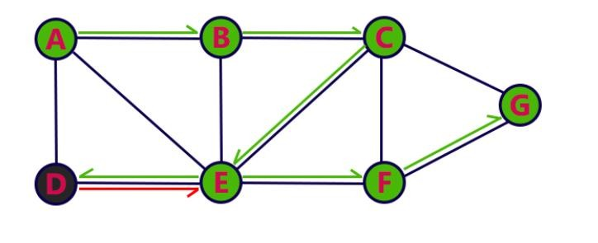
Depth First Search- STEP 8
Visit any adjacent vertex of F which is not visited ( taken G)
VISIT G
Push newly visited G into the Stack
G
F
E
C
B
A
RESULT: A B C E D F G
STACK

Slide 18

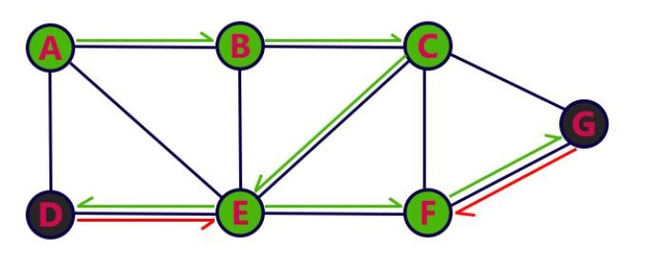
Depth First Search- STEP 9
No new vertex to be visited from G
POP G
F
E
C
B
A
RESULT: A B C E D F G
STACK

Slide 19
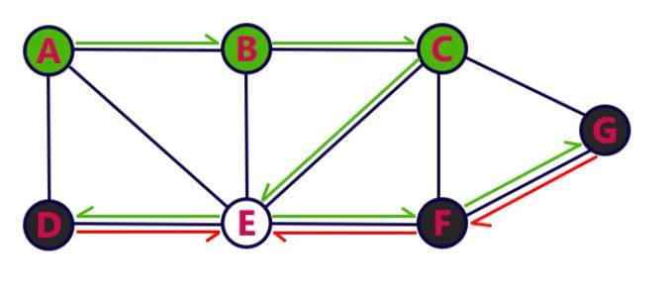
Depth First Search- STEP 10
No new vertex to be visited from F
POP F
E
C
B
A
RESULT: A B C E D F G
STACK

Slide 20

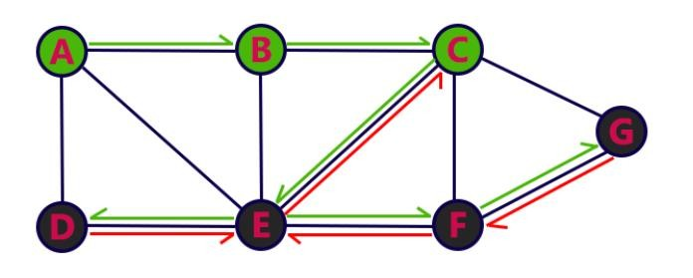
Depth First Search- STEP 11
No new vertex to be visited from E
POP E
C
B
A
RESULT: A B C E D F G
STACK

Slide 21
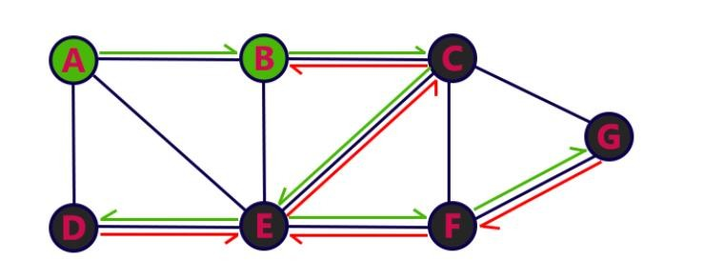
Depth First Search- STEP 12
No new vertex to be visited from C
POP C
B
A
RESULT: A B C E D F G
STACK

Slide 22
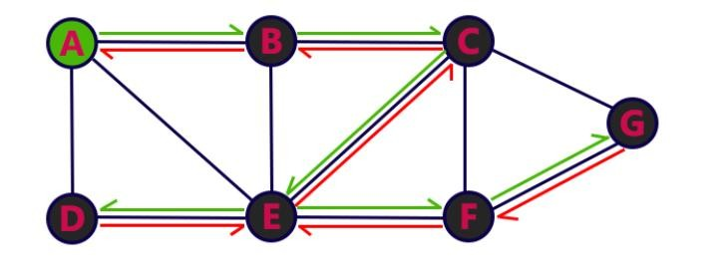
Depth First Search- STEP 13
No new vertex to be visited from B
POP B
A
RESULT: A B C E D F G
STACK

Slide 23
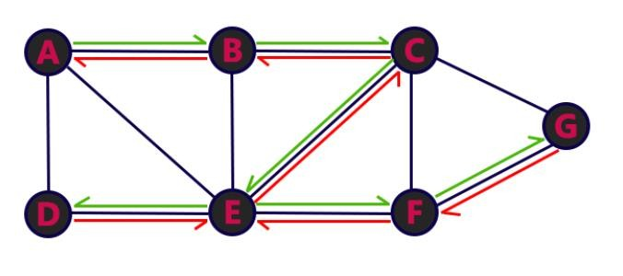
Depth First Search- STEP 14
No new vertex to be visited from A
POP A
RESULT: A B C E D F G
Stack Empty, End the DFS traversal
STACK

Slide 24
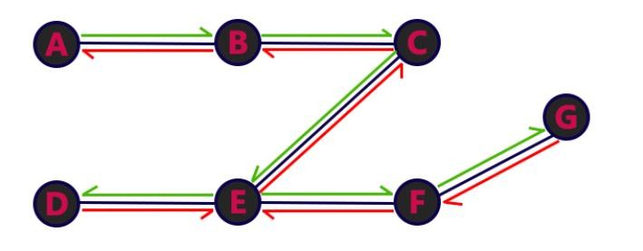
DFS Traversal - Result
A→B→C→E→D→F→G

